Slide 1
Creative Arts
Dr. Tulika
Department of Computer Science and Information Technology

Slide 2

What is creativity?
According to dictionary, the use of imagination or original ideas to create something
To come up with a new, unique, original, surprising idea
From an already existing thing
Should prove itself that it is useful

Slide 3
Creativity
Research in the arts also demonstrates that when creativity is developed at an early age, its benefits are continual and are transferred to many intellectual tasks.
Active involvement in creative arts stimulates brain connections that support learning

Slide 4
Creativity and Arts
Creative ability is the skill and talent to use our imagination to create and solve
Artistic ability includes skill and talent to create fine works of art
  Painting
  Drawing
  Sculpting
  Musical composition etc

Slide 5
Creativity ability
We are all born creative and remain creative throughout life
Creativity manifests itself in common day to day situations ehen we face mundane problems that require effective solutions
Creativity is mental, it’s the way a person thinks solves and finds solutions to a problem or case

Slide 6
Artistic ability
Artistic skills are born with a person, as a talent and its mostly physically assessed
These skills might be weak as start, but can be developed and practiced to perfection
  Example – drawing and illustration
Artistic is basically being decorative

Slide 7
Differences
Being creative – building a house
Being artistic – decorating a house
Being creative – baking a yummy cake
Being artistic – baking a pretty cake

Slide 8


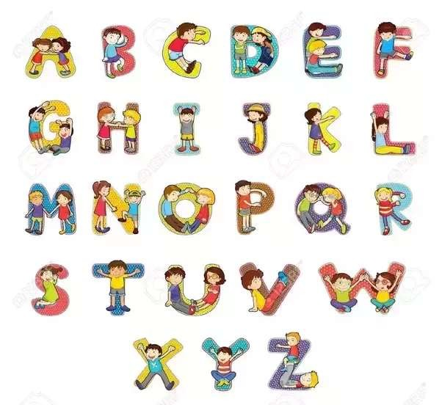
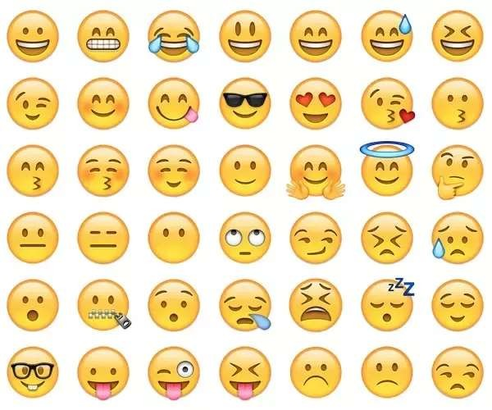
an artistic person can take
On the other hand, a
the alphabet and create a
creative person can
new typeset for the
design icons that
characters.
replace the alphabet

Slide 9
Creativity
Art is the expression of creativity
Artists are conduits of creativity
We need to find ways to open the door to express our emotions and ideas
Arts are basis of our creative expression as human being

Slide 10
Creative process
Defining the problem
Generating ideas
Selecting the best idea
Implementation

Slide 11
According to AICTE
Every student should choose one skill related to arts
  Visual art
  Performing art
Pursue it everyday for the duration of the program

Slide 12
Activities Include
Painting
Sketching
Rangoli
Collage making
crafts
Music
Dance
Play etc

Slide 13
Outcome
These activities allow for Creative expression
Develop a sense of aesthetics
Enhance creativity which will flow into engineering design later

Slide 14
Engineering Education
The National Academy of Engineers (NAE) suggests that the essence of engineering as the iterative process of Designing, predicting, performance, building and Testing.

Slide 15
“It would seem to be our responsibility to produce some creative engineers or at least not to extinguish the creative spark in the our students.”
Richard Felder

Slide 16
To develop Creativity
Know yourself
Stop trying to fool yourself and others
Carry a notebook
Ask yourself a new question daily
Develop craftmanship in your field
Read, broaden your interest
develop a sense of humor
Speculate and daydream

Slide 17
How to get good idea
For every good idea, accept to have five or ten bad or wrong or useless ideas
Creative engineers and scientists get bad ideas along with good idea
Take account of your personality and temperament
Mathematics and getting good idea
  You don’t have to be a mathematics genius
  But you should be competent in mathematics
hand on skills, laboratory skills and getting good ideas
Visualization and getting good idea
  In Engineering and scientific works it is very crucial to visualize how the work can be accomplished
Imagination and getting good idea
  Second crucial ability

Slide 18


